Slide 1
The Port of Virginia Response to the Panama Canal
NOAA Hydrographic Services Review Panel
Ms. Heather Wood
Director, Environmental Affairs
Virginia Port Authority
October 26, 2011
Notes:
Updated July 2011

Slide 2
Forecasted Global Demand Containerized Trade Grows 2X Faster Than GDP
U.S. GDP and TEU Trade: 1980 - 2010
- 40
- 30
- 20
- 10
- 0
U.S TEUs
GDP Index
U.S GDP
TEU Index (Millions)
Notes:
International trade continues to be a critical part of the US economy.
As globalization increases container trade grows faster than most other US economic sectors.
This is fortunate for Virginia.

Slide 3
Historic Port Performance

Slide 4
2010 Top 10 U.S. Ports
Rank | Port | TEUs | U.S. Market Share
1 | Los Angeles | 7,831,902 | 20%
2 | Long Beach | 6,263,499 | 16%
3 | New York/New Jersey | 5,292,025 | 14%
4 | Savannah | 2,825,179 | 7%
5 | Oakland | 2,330,214 | 6%
6 | Seattle | 2,139,577 | 6%
7 | The Port of Virginia | 1,895,018 | 5%
8 | Houston | 1,812,268 | 5%
9 | Tacoma | 1,455,466 | 4%
10 | Charleston | 1,364,504 | 4%

Slide 5
2010 Top 10 U.S. East Coast Ports
Rank | Port | TEUs | U.S. East Coast Market Share
1 | New York/New Jersey | 5,292,025 | 35%
2 | Savannah | 2,825,179 | 19%
3 | The Port of Virginia | 1,895,018 | 13%
4 | Charleston | 1,364,504 | 9%
5 | Jacksonville | 856,636 | 6%
6 | Miami | 844,996 | 6%
7 | Port Everglades | 798,150 | 5%
8 | Baltimore | 610,918 | 4%
9 | Wilmington (NC) | 265,074 | 2%
10 | Palm Beach | 216,967 | 1%

Slide 6
2010 Top Customers
Export | Import
Meadwestvaco | Target
Archer Daniels Midland | Wal-Mart
Weyerhaeuser | Home Depot
Domtar Paper | Red Bull
E I DuPont De Nemours | Lumber Liquidators
Surface Deployment & Distribution | QVC
Honeywell | Cost Plus
America Chung Nam | Lowe’s
Army & Air Force Exchange | Hooker Furniture
Fornazor International | Family Dollar Stores

Slide 7
2010 Top Trading Partners
EXPORT | IMPORT
China | China
Germany | Germany
Belgium | India
Netherlands | Brazil
Indonesia | Italy
India | Indonesia
Brazil | Netherlands
Japan | Belgium
United Kingdom | France
Saudi Arabia | Vietnam

Slide 8
2011 Complete Fiscal Year, July-June
FY 2011
FY 2010
Change
Total TEUs | 1,903,162 | 1,848,940 | +2.9
Export TEUs | 1,015,970 | 979,808 | +3.7
Import TEUs | 887,192 | 869,132 | +2.1
Total Rail Containers | 304,731 | 236,597 | +28.8
VIP Containers | 32,958 | 28,208 | +16.8
Ship Calls | 1,798 | 1,844 | -2.5
Source: Terminal Statistics
Breakbulk Tonnage | 304,626 | 222,337 | +37.0

Slide 9
World Trade Lanes Lead to The Port of Virginia
1
1
3
1
1
2
2
2
China to West Coast
India/Southeast Asia to East Coast Through Suez Canal
China to East Coast Through Panama Canal
Notes:
Trade is shifting from the traditional China to West Coast pattern
The Panama Canal Expansion
The growth of manufacturing in global regions that make the Suez Canal more attractive
The shifting trade patterns will put more pressure on the East Coast
Capacity needs to expand at accelerated rates to stay competitive

Slide 10
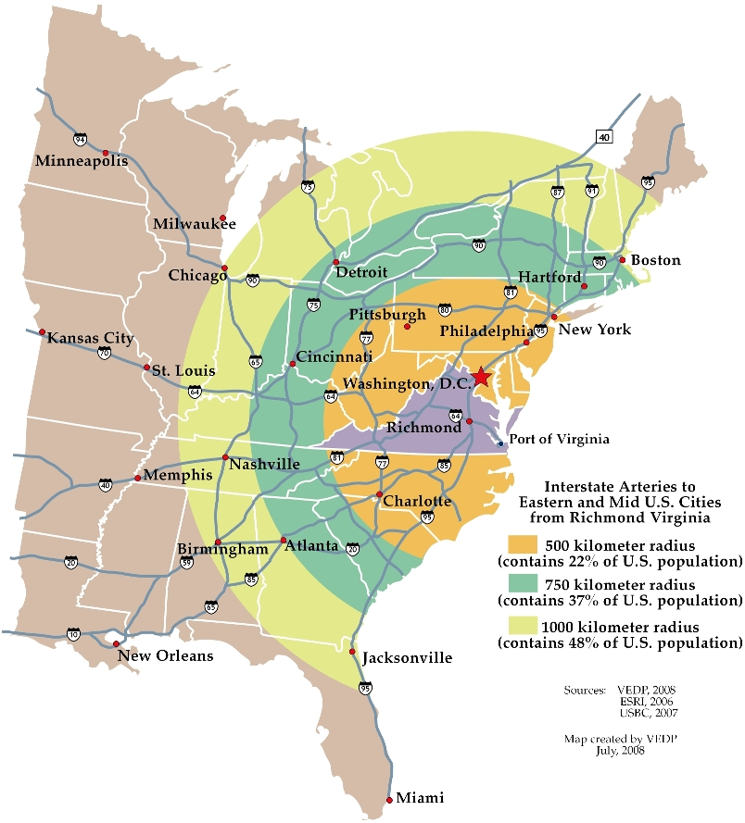
Ideally Located
Central location along the Atlantic Coast
Nearly 50 percent of the nation’s population and 50 percent of the manufacturing activity are within a day’s drive of the Port of Virginia
Well-developed transportation system provides access to major markets: The 3rd largest state maintained transportation network
The 3rd largest container port on the U.S. East Coast and the Virginia Inland Port provides an interface between truck and rail services for transfer of ocean-going containers

Slide 11
Rail Gateway to the Midwest Serviced by Two Class 1 Railroads
Expanded On Dock Rail Yard at NIT
Dual Access at APMT
Dual Access at PMT for Breakbulk and/or RoRo
CSX Breakbulk rail service at NNMT
Higher Percentage of Railed Cargo Than Other U.S. East Coast Ports

Slide 12
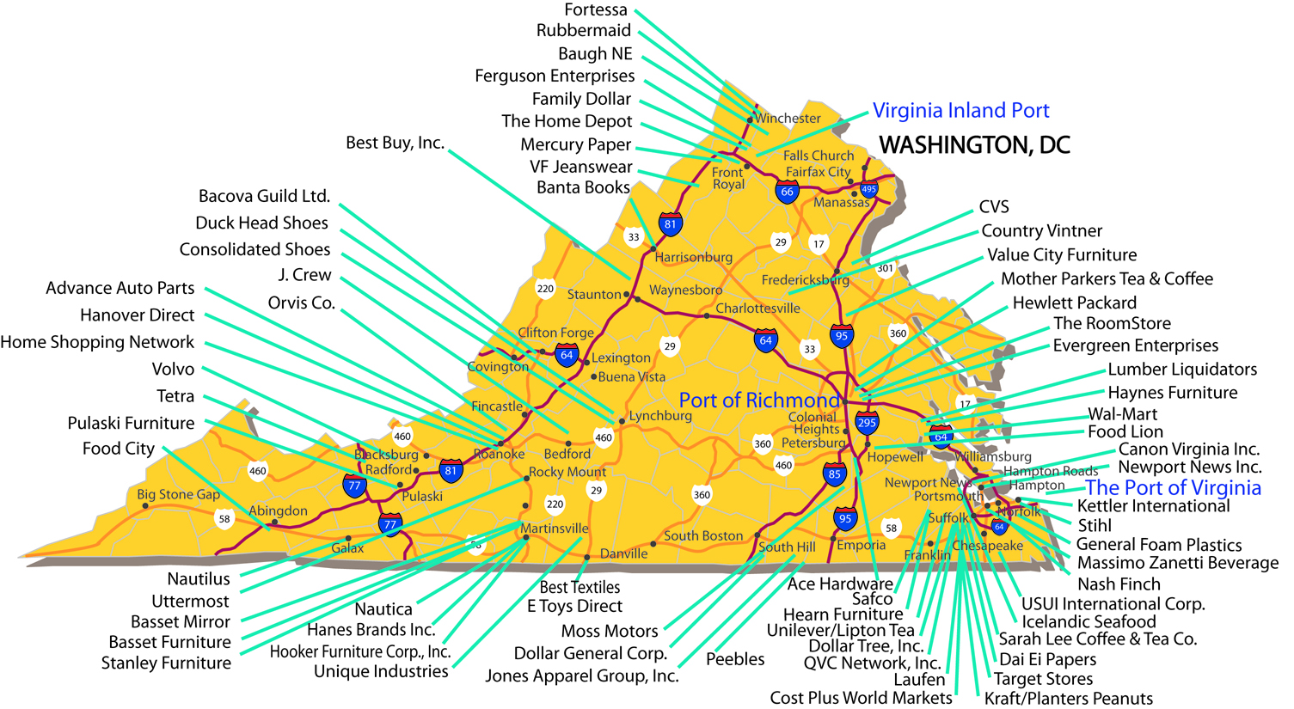
Selected Distribution Facilities Using The Port of Virginia

Slide 13
Panama Canal vs. Suez Canal
Port of Virginia
Hong Kong, China
Suez Canal
Suez Canal
Panama Canal
Via Panama Canal
Distance: 11,021 nautical miles
Via Suez Canal
Distance: 11,705 nautical miles

Slide 14
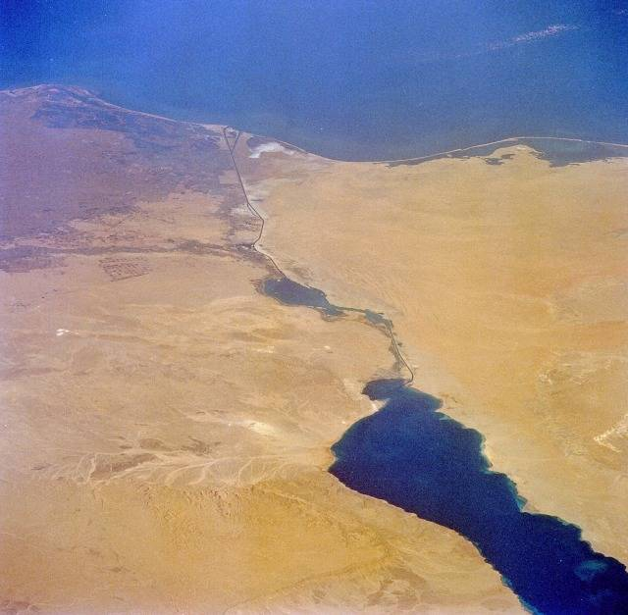
Suez Canal
Port Said
Mediterranean Sea
Lake Timsah
Bitter Lakes
Sinai Peninsula
Suez
Overall length: 120 miles Width: 590ft / 622ft Max. permissible draft: 62ft
The canal is sea level, no locks.
Gulf of Suez

Slide 15
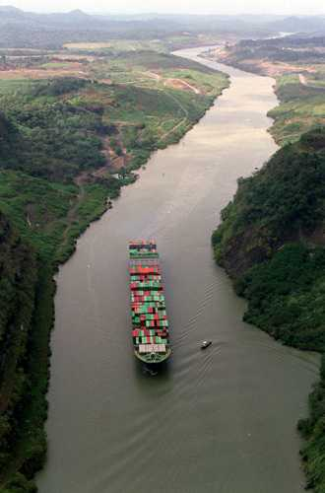
Expansion of the Panama Canal
$5.25 billion capital investment program to modernize and improve the Panama Canal
$190 million channel deepening project began in 2002
$1.6 million project to redesign a third set of locks

Slide 16
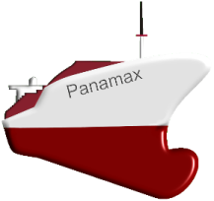
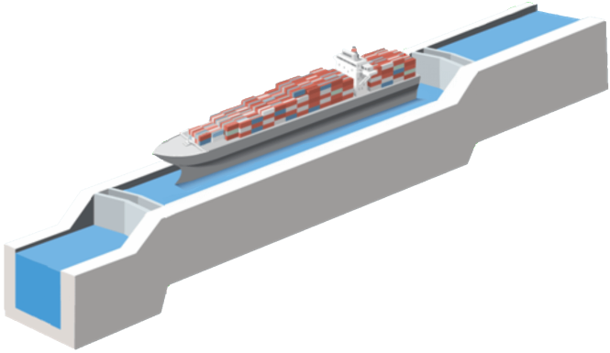
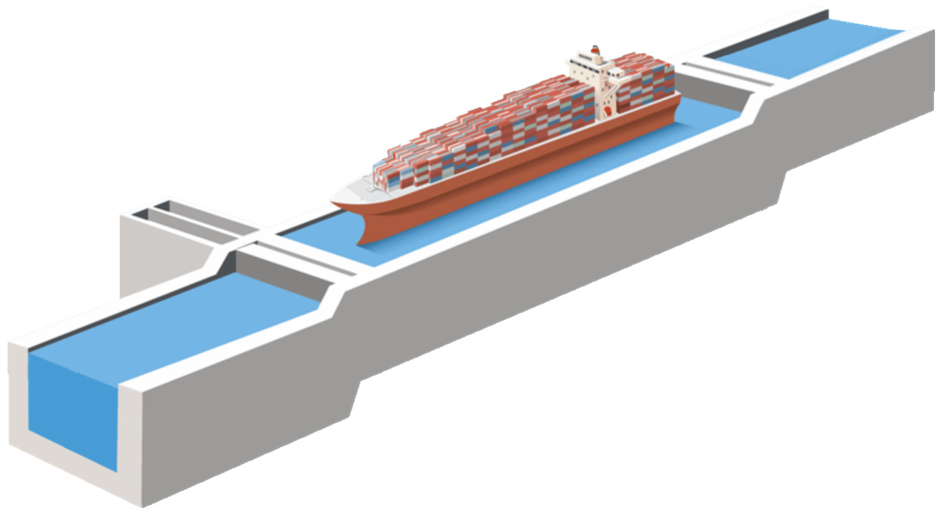
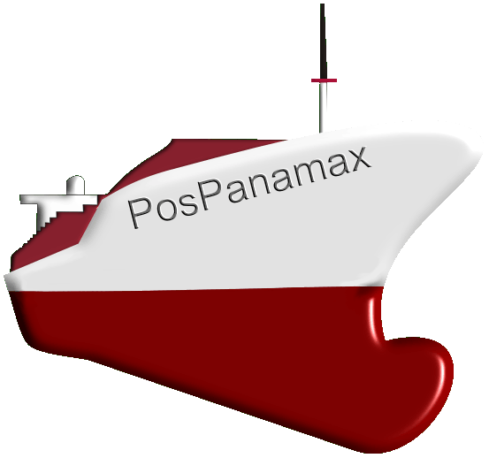
Panama Canal Expansion - New Locks Will Accommodate Post-Panamax Vessels
Existing Locks Max Vessel size:
4,400 TEU’s
294.1 m (965’)
32.3 m (106’)
12.4 m
(39.5’)
Existing Locks
304.8 m (1,000’)
366 m (1,200’)
12.8 m (42’)
49 m (160’)
New Locks
427 m (1,400’)
New Locks Will Accommodate Post-Panamax Vessels
18.3 m (60’)
15.2 m
(50’)
New Locks Max Vessel size:
12,600 TEU’s

Slide 17
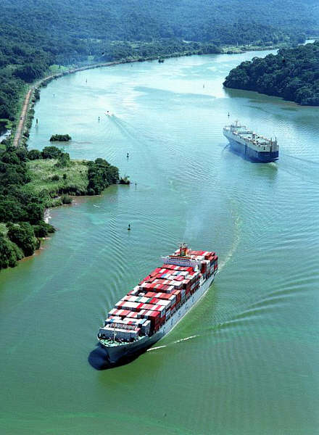
Panama Canal Expansion Will Increase Business at Port of Virginia
Route for Asia to Atlantic Ports
Completion by 2015
Virginia is the only east coast port with deep enough channels for biggest ships
Notes:
The Panama Canal Expansion adds to our level of assurance that cargo demand will continue to grow.
West Coast Ports are becoming more congested and fuel prices make it more costly every day to ship by rail across the country from West Coast Ports
The Panama Canal is almost at full capacity today. This expansion is scheduled to open by 2015 and will add sufficient capacity, and through widening and deepening, allow bigger ships to move through the canal.
The last point on bigger ships is of particular importance to Virginia. Not only will more cargo come to the East Coast when capacity is increased, but when it is moved on the largest ships only Virginia has channels, berths and cranes large enough to work these ships

Slide 18
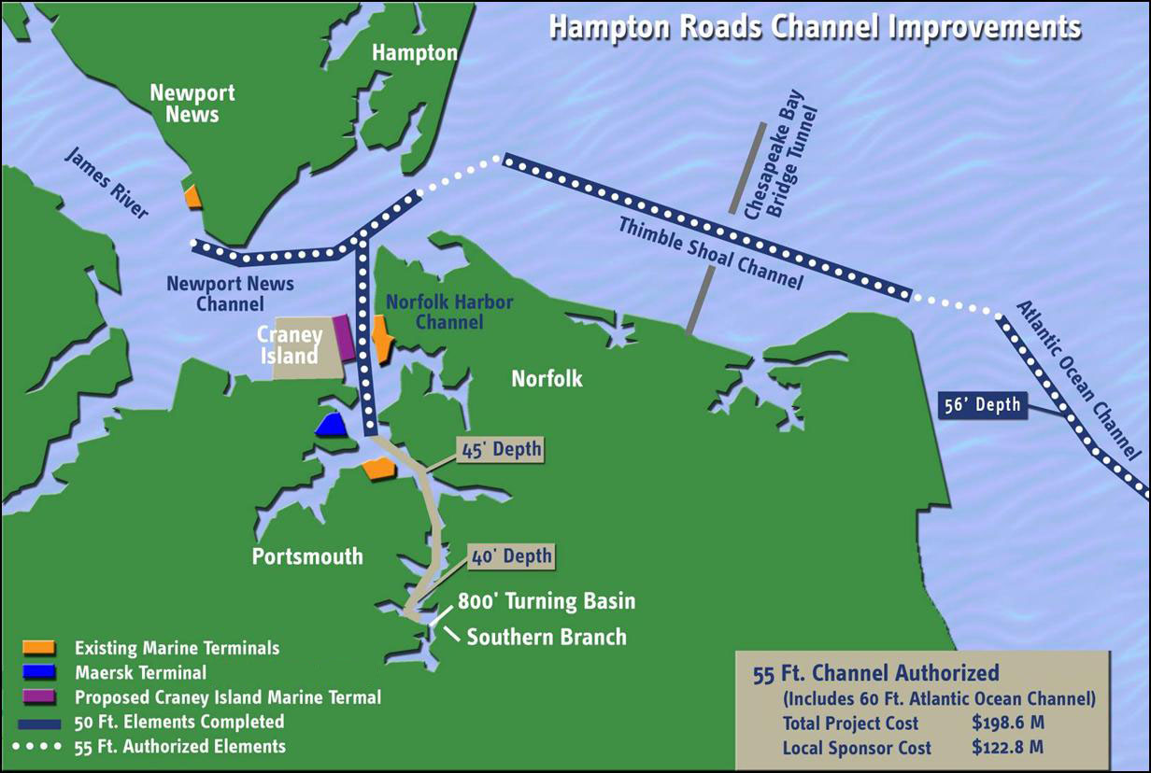
50 Foot Channel Depth
55 ft. channel authorized (includes 60 ft. Atlantic Ocean channel)
Notes:
Three Tunnel Crossings
CBBT Thimble Shoal Channel
Hampton Roads Bridge Tunnel (HRBT)
Monitor-Merrimac Memorial Bridge Tunnel (MMBT)
Available Channel Depths:
CBBT – 50 (55’ if cover reduced to 5’)
HRBT – 60 (65’ if channel re-aligned)
MMBT – 60’
Planned Third Harbor Crossing
65’ Recommended by VPA to VDOT

Slide 19
U.S. East Coast Competitive Ports Water Depth
Jacksonville
38 ft
4,500 TEU
Wilmington, NC
42 ft
Savannah
8,500 TEU
Charleston
45 ft
NY/NJ (2012)
Baltimore
Norfolk
50 ft
12,500+ TEU
Norfolk 55 ft (authorized)
Based on fully loaded vessel

Slide 20
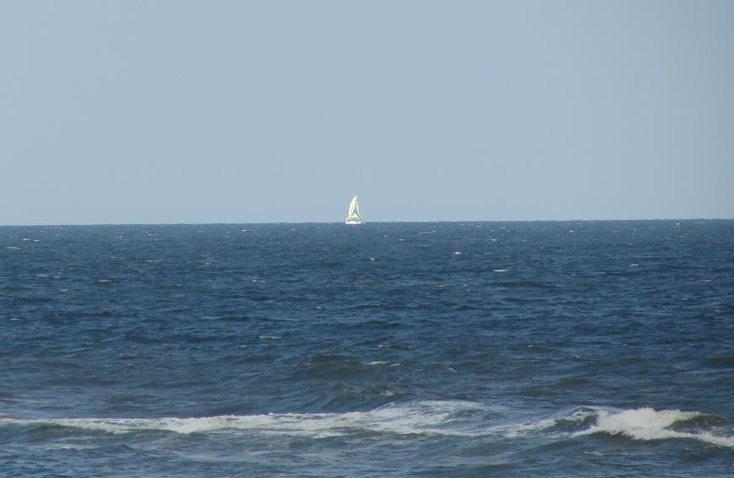
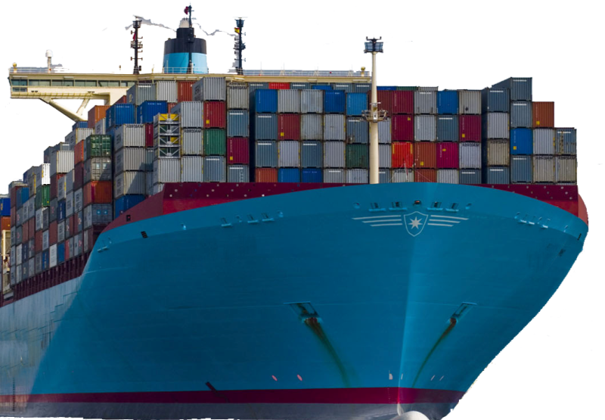
Unobstructed Access
Current minimum required clearance 190 feet
Bayonne Bridge
(entrance to Port of NY/NJ) air draft 151 feet
Emma Maersk carries 11,000-13,500 TEUS, and requires 185-195 feet of air draft

Slide 21
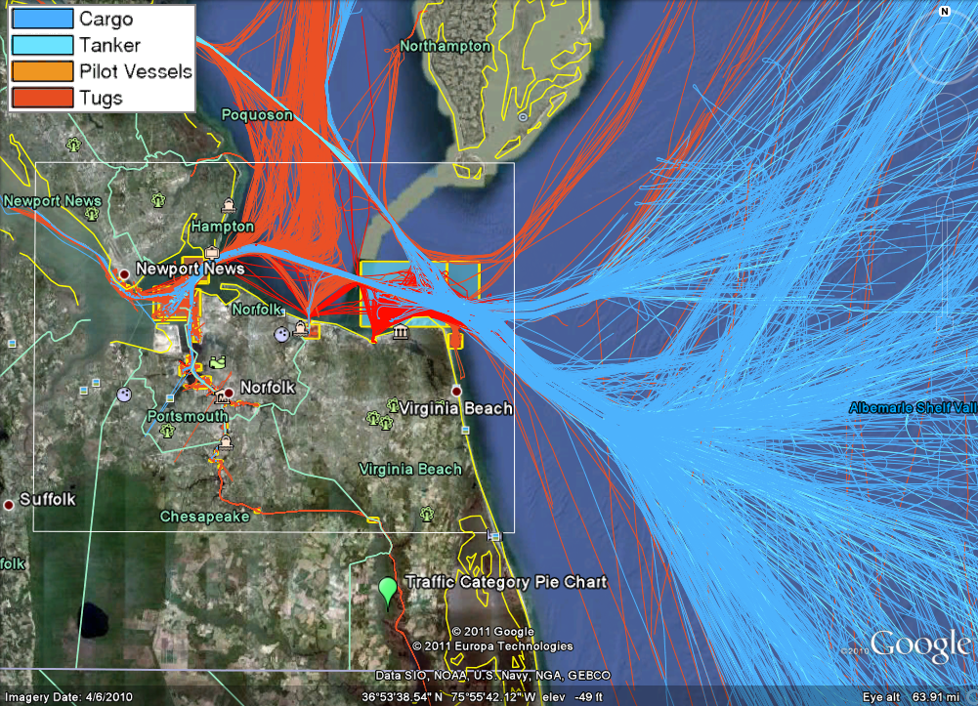
VA OS Wind Lease Blocks

Slide 22
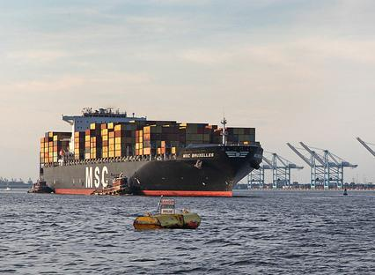
MSC Bruxelles
At 1,105 feet long, and 9,200 TEUs, the MSC Bruxelles holds the record for the biggest containership ever to enter the Hampton Roads Harbor.
Vessels of this size regularly call on The Port of Virginia
Our channels and terminals can handle these vessels fully loaded unlike any other port on the East Coast

Slide 23
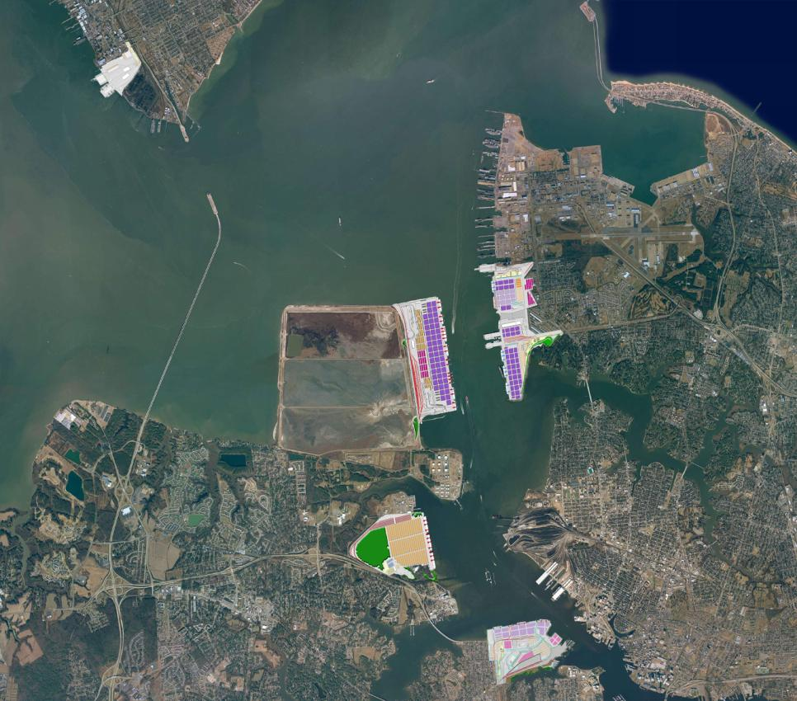
Port Briefing
Regional Transportation Projects
Chesapeake Bay
NNMT
Patriot’s Crossing
I-564 Connector
50 ft. Deep Water Access, Unrestricted Air Draft
Craney Island
Marine Terminal
CIDMMA
NIT
Craney Island Road & Rail Connector
APM
Commonwealth Railway Safety Mainline Relocation
PMT

Slide 24
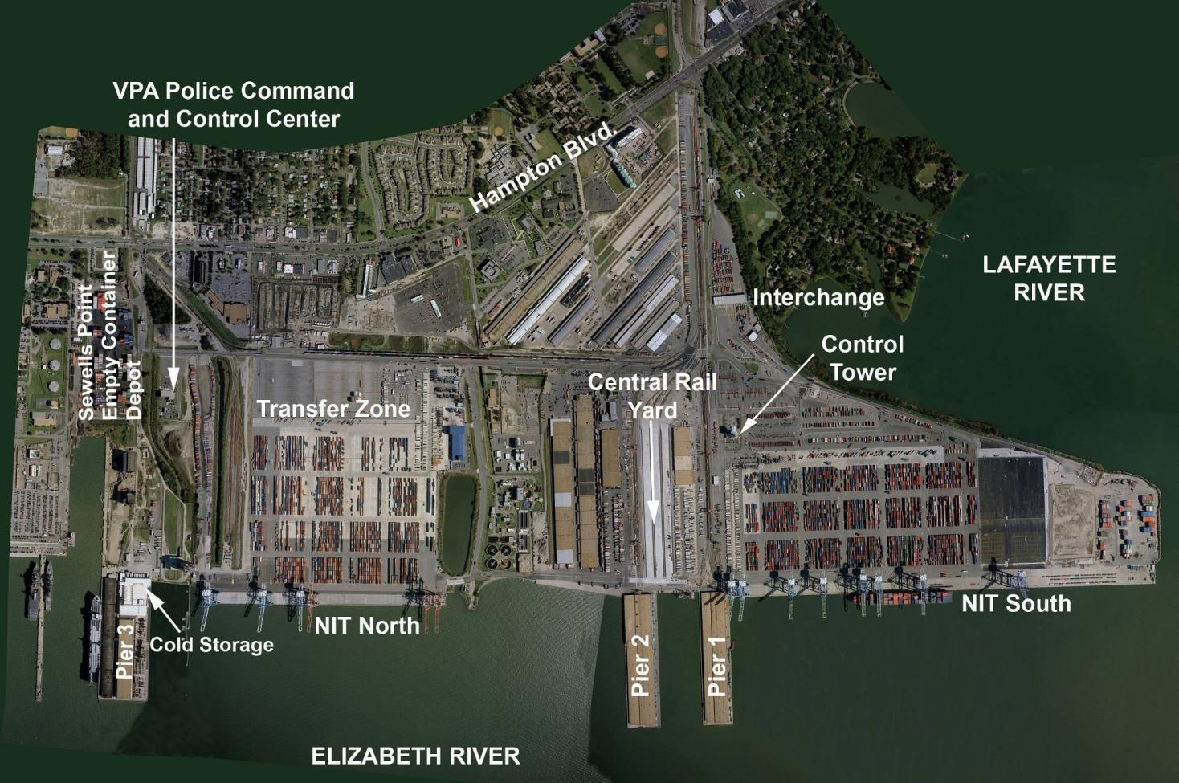
Norfolk International Terminals
Notes:
$400 Million in Facilities Investment

Slide 25
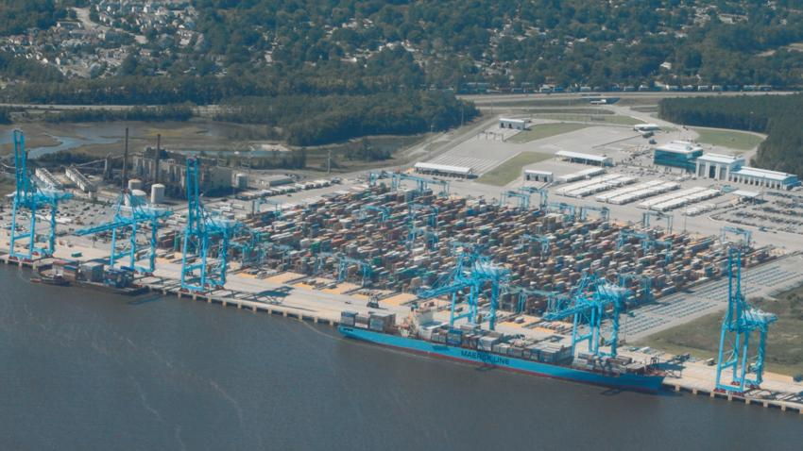
APM Terminals Virginia Leased to the VPA, Operated by VIT, Inc.
Phase 1 – Sept. 2007 Total Acreage: 230 Pier Length: 3,200 ft Depth: 55 ft Cranes: 6 Capacity: 1 Million TEUs Cost: $500 Million CSX and NS Served

Slide 26
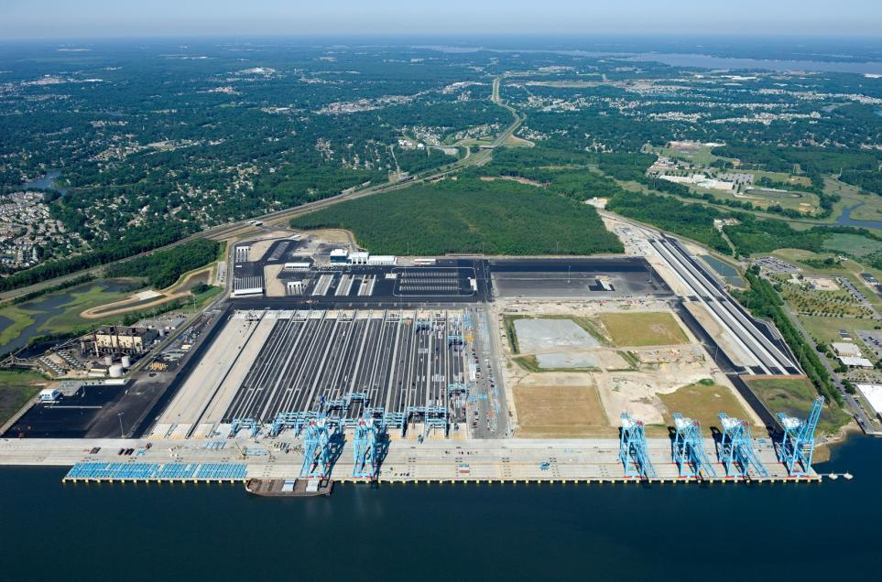
APMT Phase 2
Most Technologically-Advanced Marine Terminal in North America
Room for Expansion
APMT II
APMT I
Notes:
Phase 1 – Sept. 2007 Total Acreage: 230 Pier Length: 3,200 ft Depth: 55 ft Cranes: 6 (are the other 2 in service yet?) Capacity: 1 Million TEUs Cost: $500 Million CSX and NS Served
APM II
Open in 2016/2017
1.1 M TEU +/- capacity
$250 M +/-

Slide 27
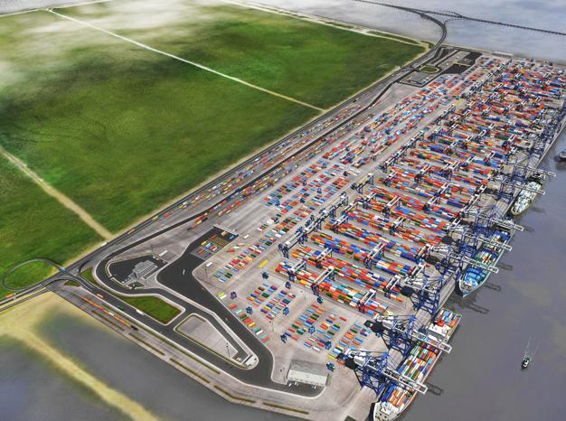
Future Craney Island Marine Terminal
Phase 1 – June 2025
Total Acreage: 220 Pier Length: 3000 ft. Depth: 52 ft. Cranes: 6 Capacity: 1.5M TEUs Cost: $1.2B

Slide 28
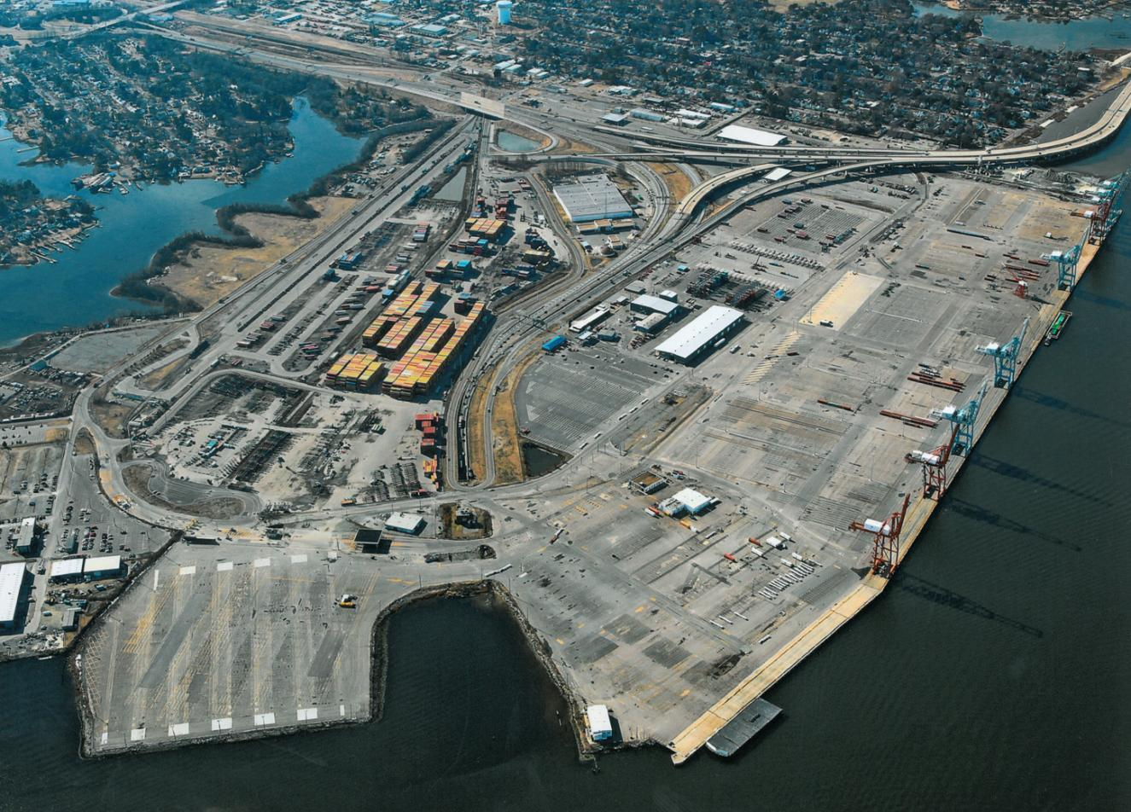
Portsmouth Marine Terminal
Land Area: 285 acres (land and pier only) Direct rail service with CSX; also Norfolk Southern via Norfolk and Portsmouth Belt Line. Shipside rail service is available

Slide 29
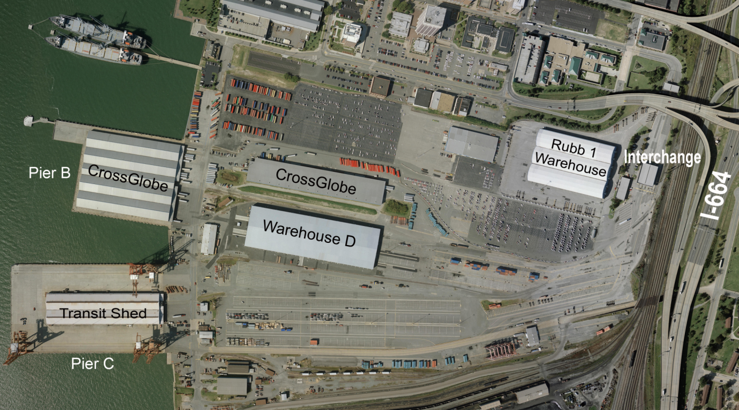
Newport News Marine Terminal
WWL Auto Processing

Slide 30
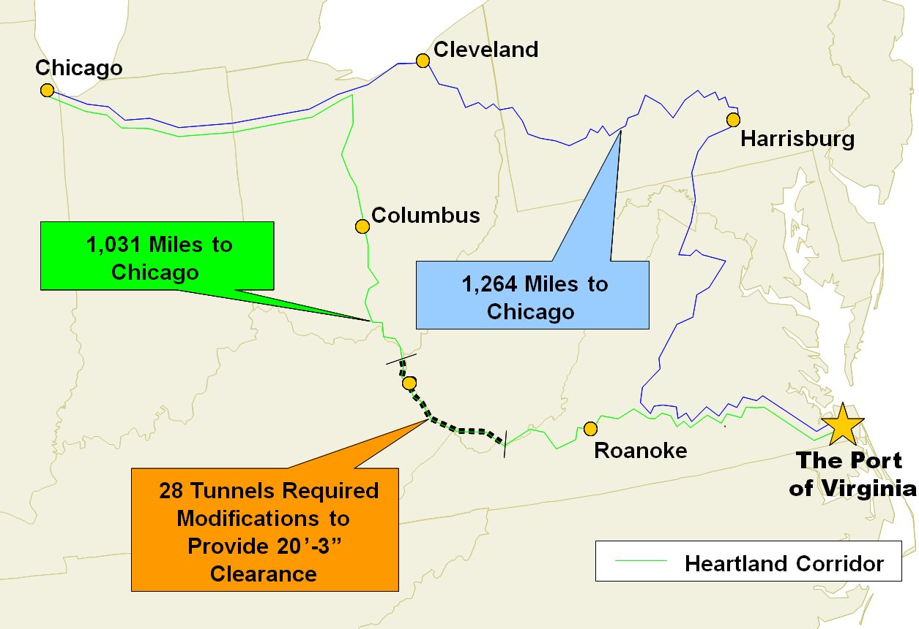
The Heartland Corridor
New route is double-stack eliminates more than 230 miles. Opened Sept. 2010.

Slide 31
The National Gateway
Connects Norfolk to the Midwest and beyond
Chicago
Pittsburgh
NY/NJ/PA
NW Ohio Transfer Yard enables CSX service to new major markets
Columbus
St Louis
Norfolk
Expedites traffic through Chicago and St. Louis gateways
Memphis
Birmingham
Atlanta
Jacksonville
CSX National Gateway
CSXT double stack routes
Other CSXT routes
New Orleans
Tampa
Miami

Slide 32
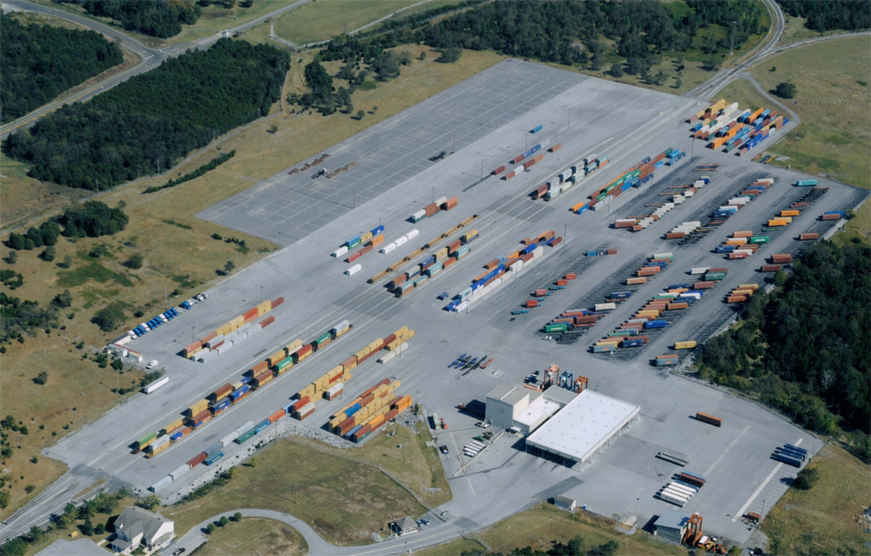
Virginia Inland Port
Five-day-a-week rail service between the VIP and the Hampton Roads marine terminals
Within 1 mile of Interstate 66 and within 5 miles of Interstate 81

Slide 33
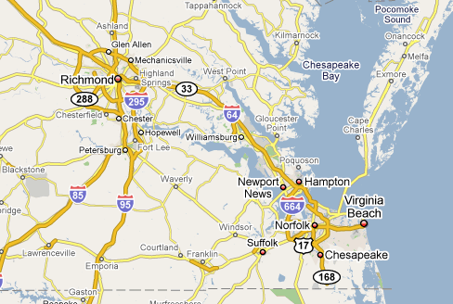
James River Barge Line – 64 Express
Weekly calls between the Port of Virginia and the Port of Richmond
Calls at NIT and PMT
Door service availability
Green transportation alternative

Slide 34
The Port of Virginia's Response
OPEN FOR BUSINESS – NOW!
22 Suez/Post-Panamax Cranes
50’ - 55’ Channel
No Air Restrictions
2 World Class Rail Roads
$2B+ Infrastructure Investment
Notes:
Modern Terminal Facilities
Unparalleled Natural Assets
Ranked #1 State for Business by CNBC & FORBES

Slide 35
How You Can Help?
Maintain unobstructed deep water channels & approaches
Safe efficient passage on approaches in all but extreme weather conditions
Continued Data Collection & Dissemination
Recognize the future of the Port and the Opportunities for Virginia & the East Coast
Communication & Education

Slide 36
Hydrographic Services Review Panel Norfolk
Ms. Heather Wood
Director, Environmental Affairs
Virginia Port Authority
October 26, 2011
Notes:
Updated July 2011

